Slide 1

GROWTH HACKING

Slide 2




what's going to happen here ?
Growth Hacking
What | Why | How
Or in simple terms Contents
Scope of Growth Hack in Your Career

Slide 3



What Is Growth Hacking?
Notes:
If you ask 10 people the question “what is growth hacking” you will probably get 10 different answers. There’s still too much misconception or confusion (and fear) around this term. But in fact, it’s very simple: growth hacking is a data-driven methodology and collection of smart marketing techniques. They are focused on reaching scalable growth of businesses.
Many startups use Dave McClure’s “pirate funnel” as a recipe for growth. These are awareness, acquisition, activation, retention, referral, and revenue (AAARRR). Others include raising awareness as a key part of growth hacking. Either way, the point is to get traffic and visitors, turn visitors into users, and retain those users as happy customers.

Slide 4

Growth Hack
Growth hacking concerns outside-the-box marketing strategies used to get the maximum number of users with minimal spend.
It’s a field focusing solely on growth, based on a data-driven, experiment-based process.
Growth Hacking isn’t just marketing-done-well ?
AAARRR
AWARENESS, ACQUISITION, ACTIVATION, RETENTION, REFERRAL, AND REVENUE

Slide 5


Sean Ellis, founder and CEO of GrowthHackers
He coined the term Growth Hacking in 2010.
Notes:
He coined the term “Growth Hacking” to describe the sustainable growth approach used by hyper-growth companies like Facebook, Airbnb and Amazon.
He has directly led growth at Dropbox, LogMeIn, Lookout, and Eventbrite

Slide 6

Growth Hacker
Speed > Perfection
Make data-driven decisions
Always be improving
A growth hacker is a person whose true north is growth.
Notes:
Growth hackers trace their roots back to programming engineers. But they are much more than that.
They are creative marketers, product managers, and data analysts as well.
They are focused on a singular goal: finding the most effective and efficient way to grow a business.
This often involves rapid experimentation across marketing channels, constant attention to product (re)development and an unending focus on building and engaging a company’s user base.
Most importantly, every decision a growth hacker makes is based on data.
A growth hacker knows how and what to measure. They use analytics, landing pages, and A/B testing to understand their target customers’ habits and behavior.
While they don’t make assumptions, they are instead obsessed with data, until they find the most effective solutions with the most potential for growth.

Slide 7
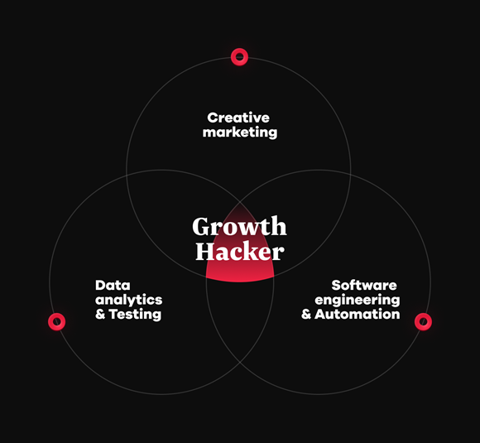
GROWTH HACKER SKILL COMBINATION
Notes:
Growth hackers experiment, test, and are always pushing limits with unconventional acquisition strategies. Growth hackers are often dancing with the devil, frolicking in grey hat territory where more established companies tend not to wander. They aren’t afraid to work around the system, hence the title “hacker”.

Slide 8

The 7 pillars of Growth hacking
A methodology for achieving exponential growth.

Slide 9
7 PILLARS
GROWTH MINDSET
GROWTH
TEAM
MEASUREMENT
LISTEN TO YOUR MARKET
PRODUCT-MARKET FIT
RIGHT TRACTION CHANNELS
OPTIMISATION
Notes:
1. Achieving the growth mindset
Growth hacking starts with the right mindset. for example, “to achieve 10 million in revenue by 2022”. It is very important that your Aim is measurable, achievable and straightforward so you can always keep it in mind letting it guide your team’s every move.
One Metric that Matters (OMTM)
2. Building a growth team
No single person can be an expert in every area, which is why having a solid team is so important.
3. Measurement, how and what?
Data collection and analysis is the optimum way to know what exactly correlates with success. It gives you a baseline to which you compare your performances as you experiment.
Google Analytics
4. How to Listen to Your Market
5. The Product-Market Fit (P.M.F)
6. Use the right Traction Channels
7. The Key to Optimization
When Gmail launched, it used an invite-only system to drive growth, and it worked. The fear of missing out (FOMO) is a powerful marketing technique, and if you have a product people really want, they’ll respond to this type of marketing
Use this growth hack with caution, though. Google has used it again with other now-defunct products which turned out not to be popular (such as Buzz, Wave, and the almost unrecognizable Google+).

Slide 10

Growth Hacking Techniques
Referral marketing
Content Marketing
Scarcity Principle
Constant testing
Some Effective Techniques
Notes:
Clickbaits – data from Kaggle.com

Slide 11

Growth Hacking Tools
“Just 5 more slides to go !!”
Hotjar
Landbot.io
Colibri.io
PushCrew
FOMO
Hootsuite
Some Effective Tools
Notes:
Hotjar is a heatmapping tool. Hotjar gives you great insights into the behavior of your users through heatmaps and recordings of your website visitors in action.
Landbot gives you the possibility to quickly and easily create your own chatbot.
Colibri.io is a tool for monitoring the internet. It gives you an idea of what people are saying about your product or any self-chosen subject, and it gives you the opportunity to approach these people.
“Push notifications” is one of the latest channels in marketing since it became possible to send notifications without people having to download your app. If you install PushCrew on your website, you can send notifications to site-visitors about new offers, new blog posts or keep people informed about their order.
Everyone knows the Booking.com-warnings, like “Only 2 rooms left in this hotel”, “76 others are looking at this hotel right now” and “Someone from Amsterdam has just booked this room”. Very annoying, but it does works to be honest. We call that the scarcity-principle or “Fear Of Missing Out” and that is exactly what this eponymous company does for you: notifications and fomo-statements.
Hootsuite gives you the possibility to manage all your social media channels from one place.

Slide 12
Myths About Growth Hacking
Myth
Growth Hacking Is A Cheat Sheet Of Secrets On Growth
Reality
The secret is the mindset, not the toolset.
Myth
Growth Hacking Is Marketing
Reality
Growth hacking has marketing goals but different tactics.
Myth
Growth Hacking Is A New Thing
Reality
Growth hacking is not an entirely new thing.
As the demand for growth hackers are increasing, so is myths about Growth Hack

Slide 13
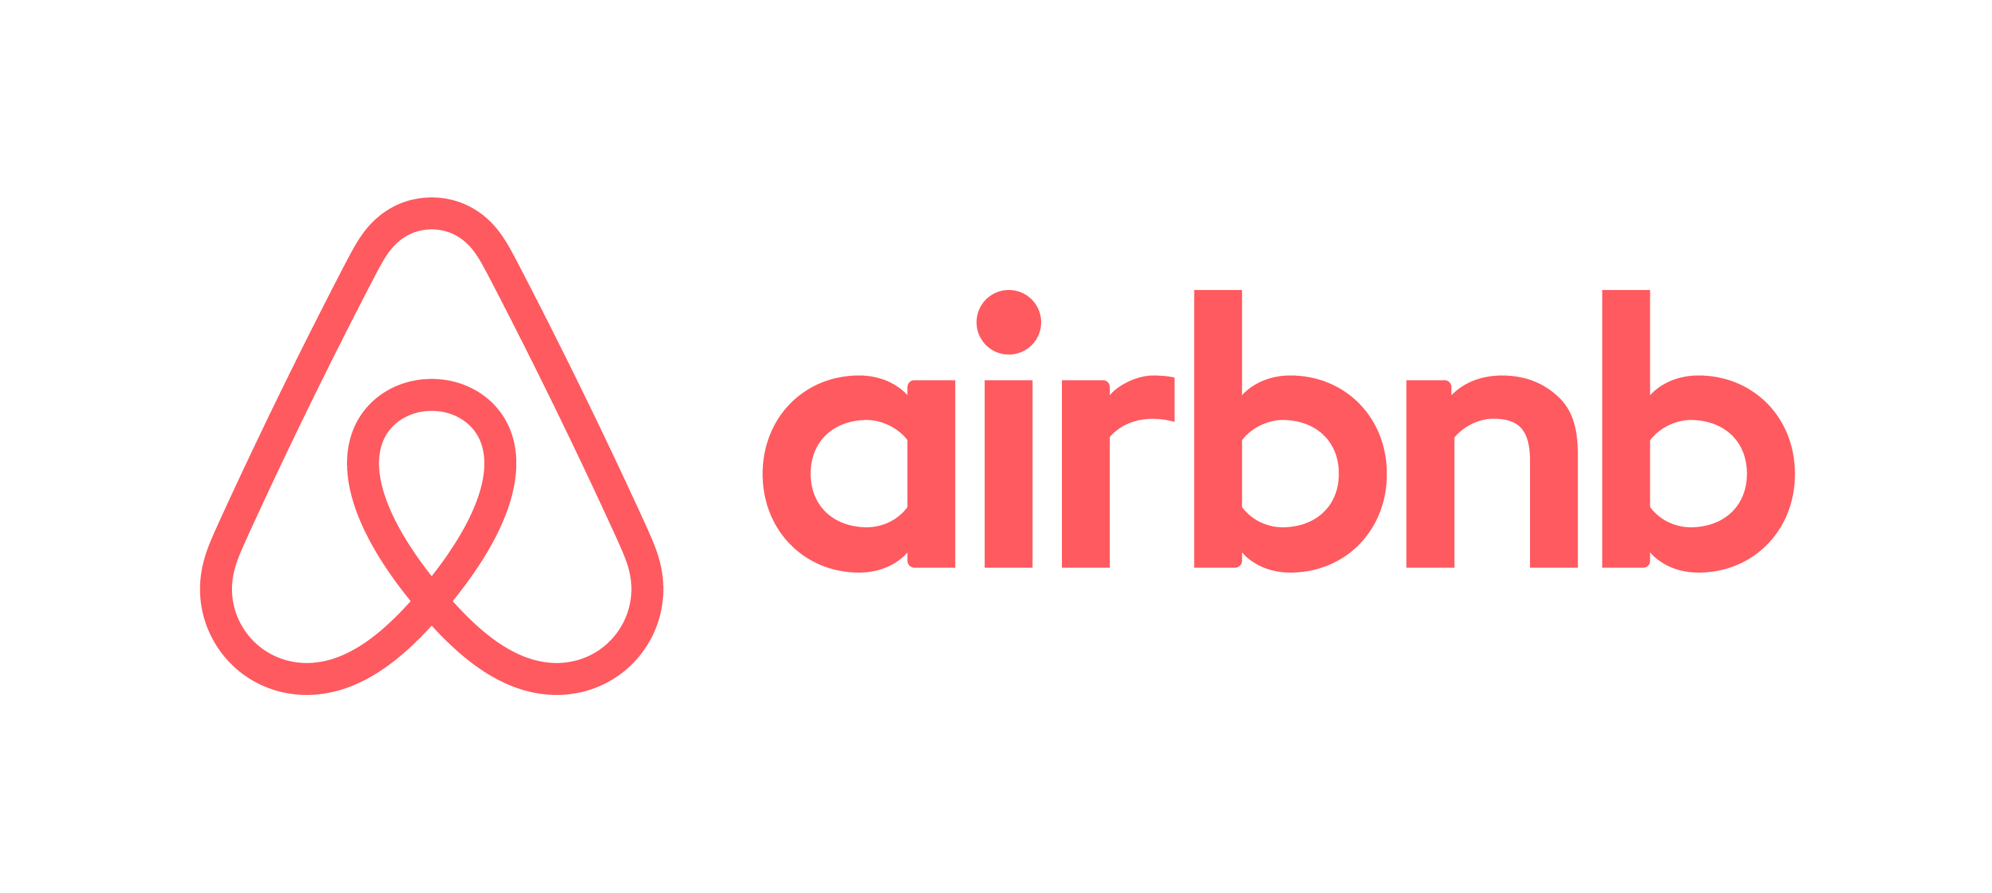

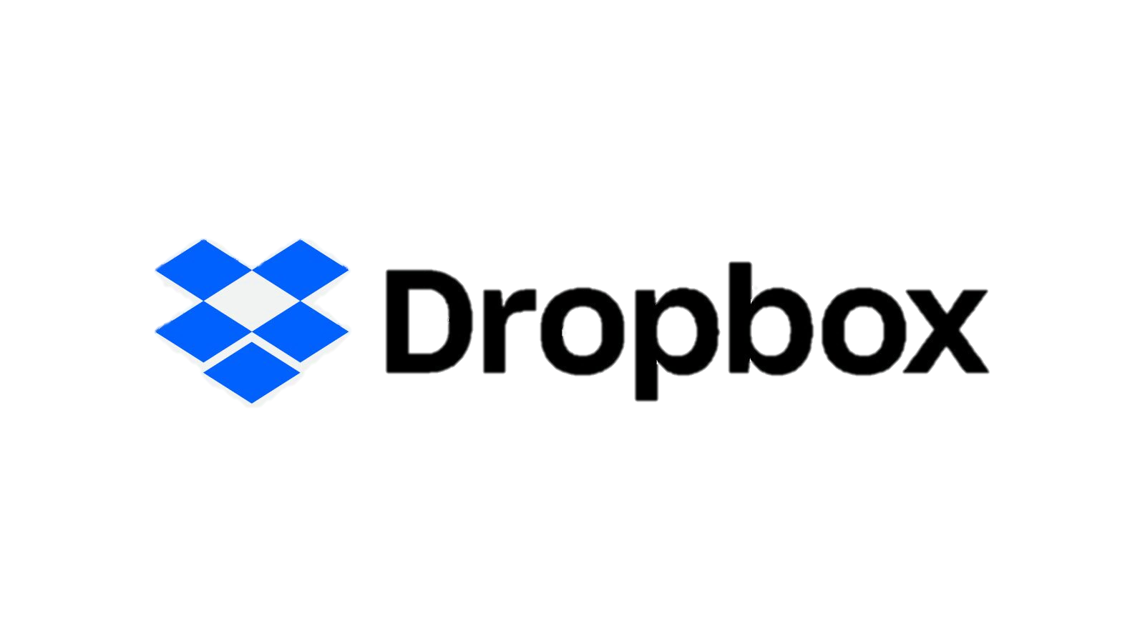



SUCCESS STORIES
Notes:
No one said that you should copy them to reach a certain success.
Instead, take them as inspiration.
These examples should inspire you to think differently and dare to experiment.
As you know, in Growth hacking, there is no perfect recipe, only a never-ending circle of testing and learning.
Dropbox turned down a 9-digit acquisition offer from Steve Jobs.

Slide 14


GROWTH HACKING YOUR CAREER
Networking Growth Hack

Slide 15

Tips on what to do to help growth hack your career
Network
Volunteer
Publish
Stay up to date
Notes:
Stay up to date on the companies in which you ultimately would like to work.
Unintentionally get more than you give.

Slide 16


Questions
Or more like Open Discussion
Keep Pushing Your Limits
Sundar Pichai

Slide 17

Thank You For Your Attention
Signing off
Leo K A
Proud GECBian

